Slide 1
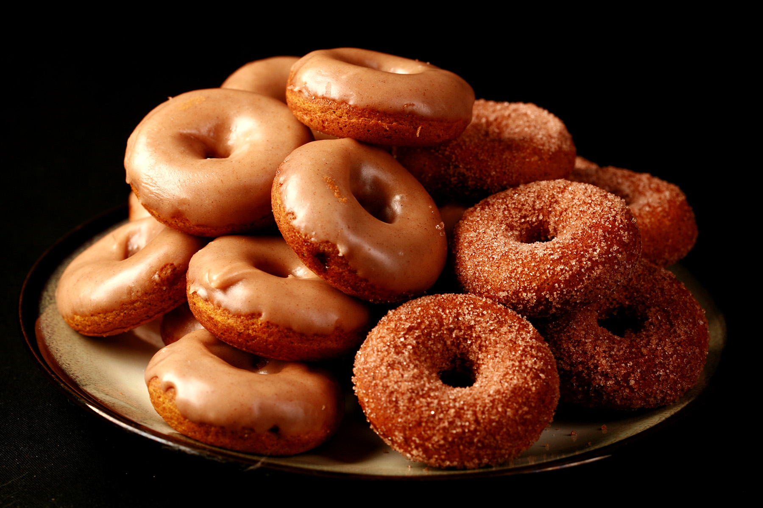
JJR

Slide 2
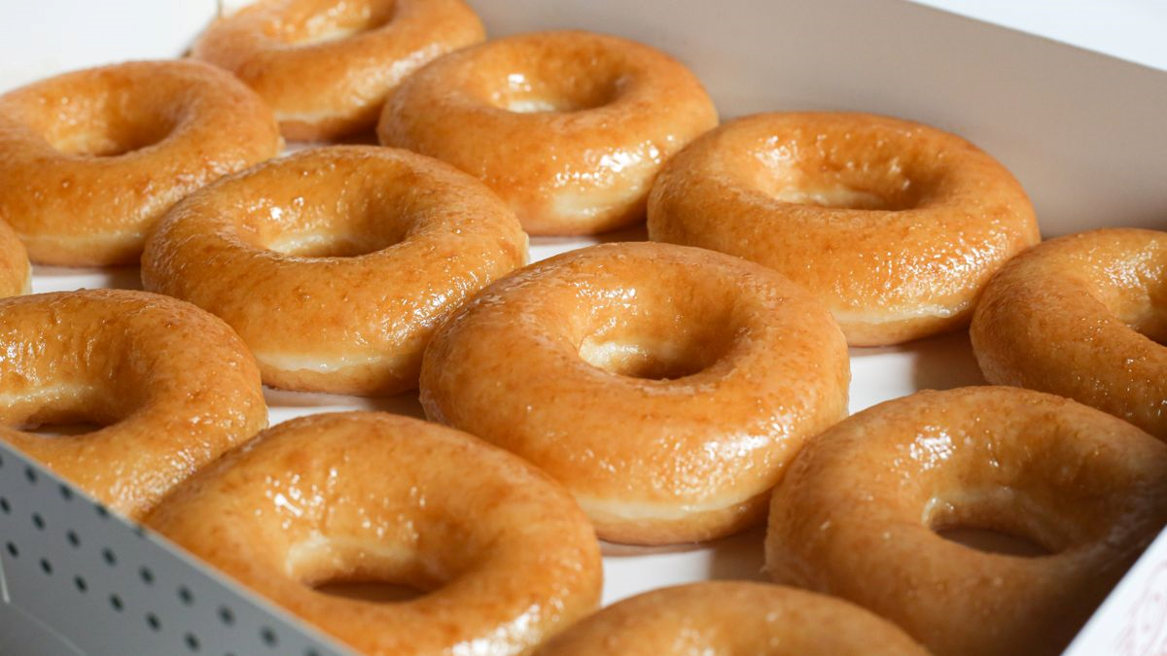
BUSINESS COST
Starting Budget: PHP 50,000
VARIABLE COSTS:
Ingredients: PHP 15,000/ Month
Packaging: PHP 3,400/ Month
Promotion(or Marketing): PHP 2,500/Month
UTILITIES(under of variable costs):
Water: PHP 600/Month
Electricity: PHP 2,000/Month
FIXED COSTS:
Rent : PHP 3,000 /Month
ONE-TIME COSTS:
Cooking Equipment: PHP14,000
Signage and Interior Design: PHP 4,500
Business Registration and Permits: 5,000 PHP

Slide 3
PROFIT
Expected daily doughnut sold per day = 300 pcs
1 pc/s = 9 pesos = 300 pcs * 12 pesos = 3,600 pesos
300 pcs * 30 days = 9,000 doughnut pcs per month
9,000 doughtnut per month * 9 pesos = 108,000 pesos per month
utilities 2,600 + 7,500 + 2,500 = 12,600 pesos per month
108,000 pesos from doughnut per mont
- 5% taxes per month 5,400 pesos per month
= 102,600 pesos
- 12,600 from utilities/labor/etc
= 90,000 pesos profit

